Slide 1
DEVELOP AN OUTCOME L2
Evidence of Learning Template
0136218313
Project Title
Python Quiz By Max McCallum

Slide 2
Github /Drive link
https://drive.google.com/drive/folders/1qZxB8mJehUaWLc8khPRcwflvQHqE6PH1?usp=sharing
Trello board or PM link
https://trello.com/invite/b/gzQjs901/a34bd988b2d17ef21285bb2220bb273f/py-quiz-plan
You MUST provide evidence showing how the problem has been decomposed, how the components have been developed and trialled, and of how they have been assembled and tested to create a final, working outcome.

Slide 3
Project management - Setup
On the first day of the assignment i focused on what i should make the project about. At first there wasn’t a lot that came to mind as i was trying to come up with ideas of things that would only implement the techniques that we learnt but i soon realised that nothing was stopping me from learning more online.
The first proper idea for a project that i had was a quiz, however i thought that this was too basic and so i didn’t commit to it straight away. I came back to this idea because i knew that this would be something that i would enjoy doing and also that to make it more advanced i could put in some other features. I didn’t want to go overboard with the amount of things i added to the code as i knew i had a limited amount of time.

Slide 4
Project management - continued
An idea i had that i could add to the quiz was the ability to select a language. I thought to myself that i should stick with that for now as i knew that a language select feature would lead onto other features just as complicated. My first thought was to have three different languages, English, French and Spanish. All of these are among the most widely spoken languages around the world and that way i could reach a wider audience. Mandarin is the Most spoken language in the world and i knew this, but i also knew that if i implemented this then there would be some other complications because Mandarin doesn’t use the latin alphabet like French, Spanish and English do.

Slide 5
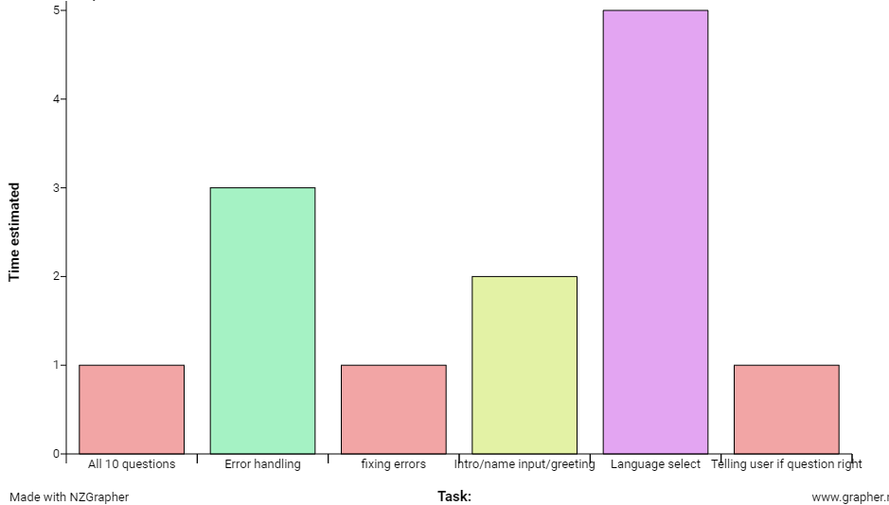
Decomposing Outcome
To plan and estimate how much time i would spend on this project, i created a bar graph on NZgrapher which displays an estimate for each aspect of the code. By having this data i could set aside smaller tasks and focus on the larger ones like error handling and language select, allowing me to have more time to improve them.
However, This plan didn’t completely work as it was implying that i was able to do everything separately without needing to do something else before hand. So instead i found myself doing the tasks in chronological order from whatever would come up first when a user plays the quiz, for example, the first thing that they see would be a message that says ‘Welcome to the quiz’ and so this is what i did first and so on

Slide 6
Project management - Trello
I used the website Trello to help me with the development of my website, it has many useful tools which i took advantage of such as a feature where i get an email on the day i set for myself to complete one of my tasks. This was useful because i was able to keep track of my progress and know if i was behind on anything and needed to catch up. The main purpose of Trello is to show what you need to do, what you are in the process of doing and what you have completed.
Another website I considered was Mondaye.com and although it seemed relatively easy to use, it looked more suitable for group projects rather than individual projects so i decided that Trello would be the best for me to use.

Slide 7
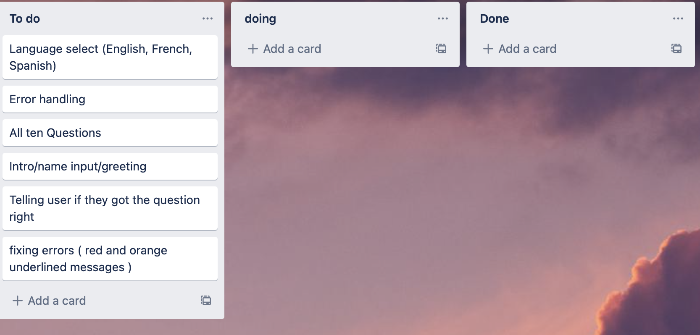
Trello Board at the start of the assessment

Slide 8
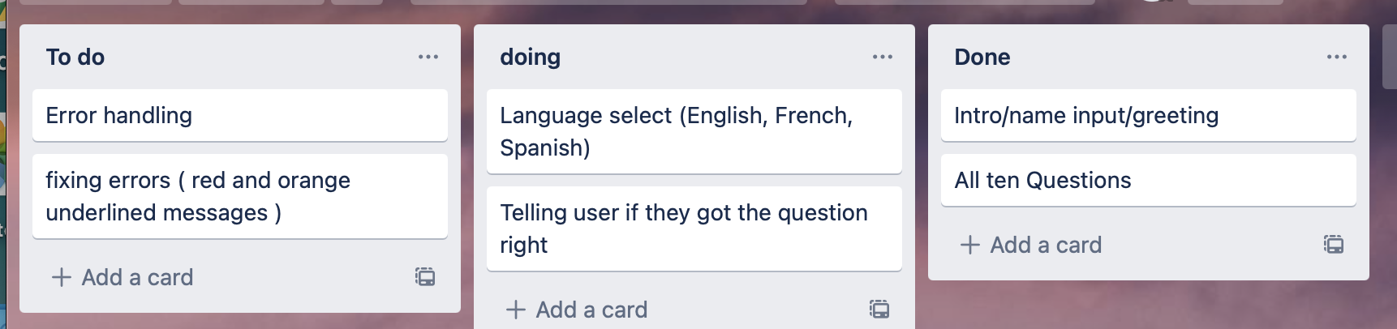
Trello board midway through the assessment

Slide 9
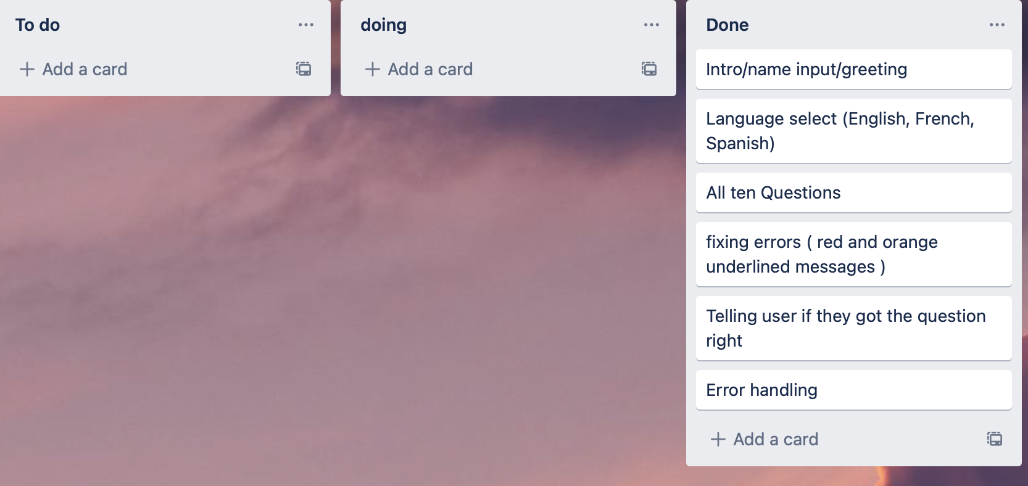
Trello board at the end of the assesment

Slide 10
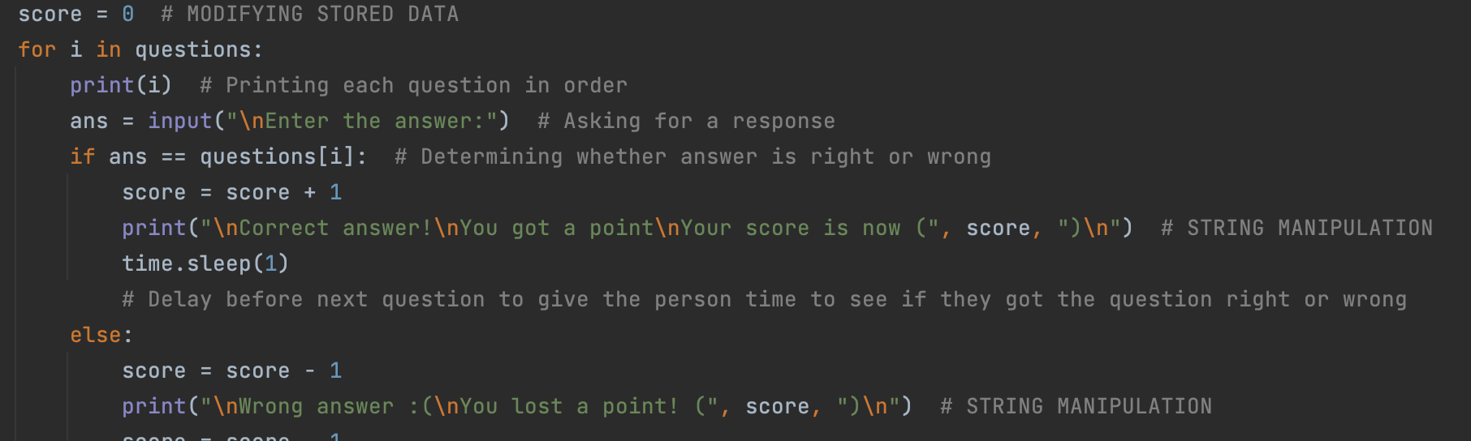
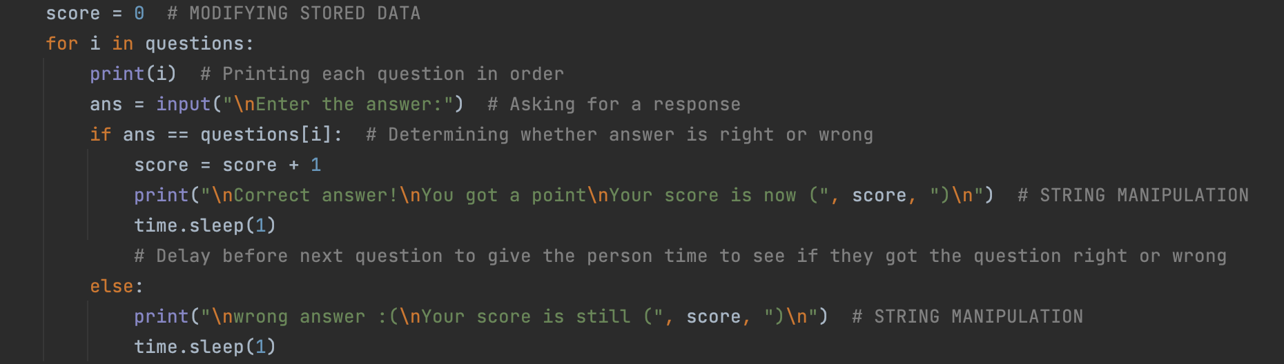
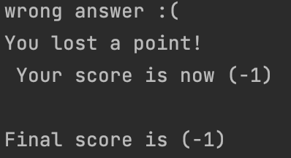
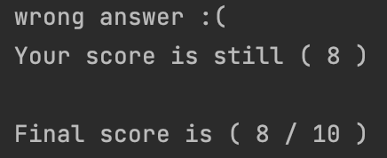
Trialling components - Recording score
To begin with, I had the program keep track of the users score by adding a point when they got a question right and taking a point off when they got the question wrong. However, after trialling this feature multiple times, I decided to remove the part where it removes a point if the user gets the question wrong as I don’t think that it is a good indicator of the users skill level because their overall score might say 0 which could be quite misleading considering that they got 5 questions right and 5 questions wrong.

Slide 11
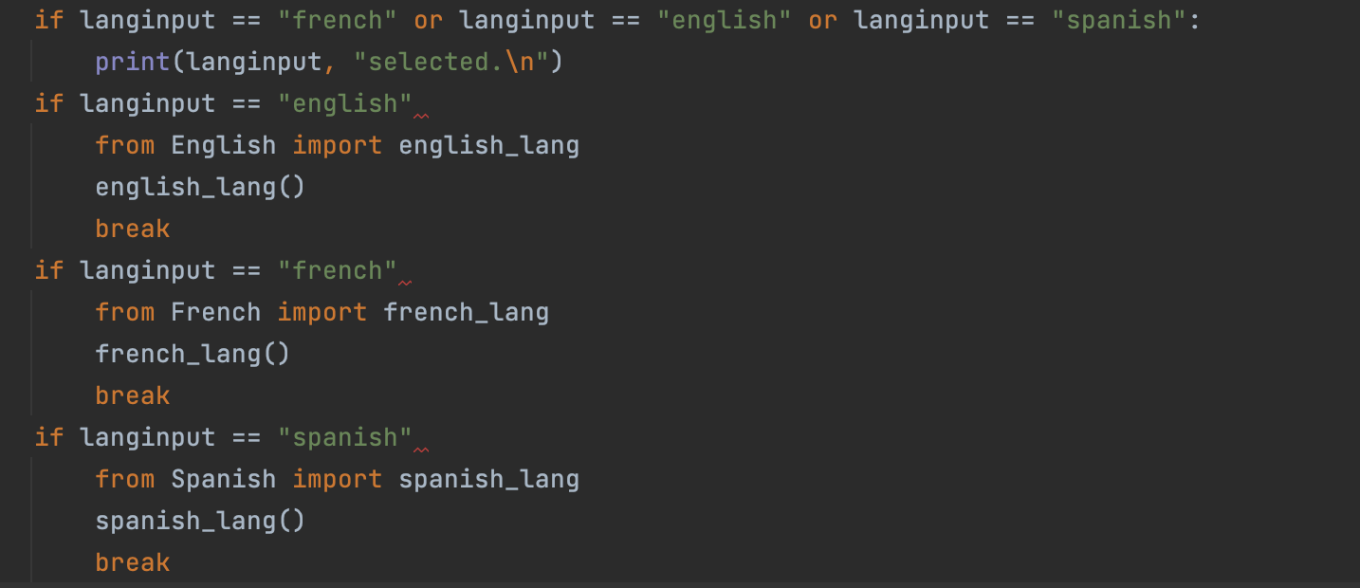
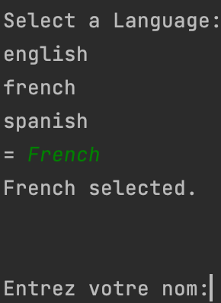
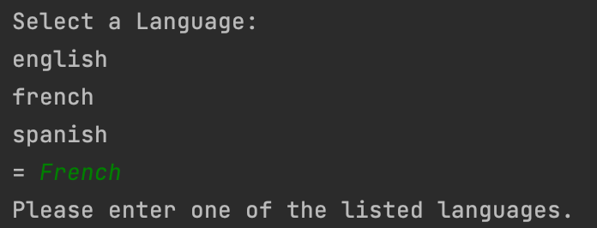
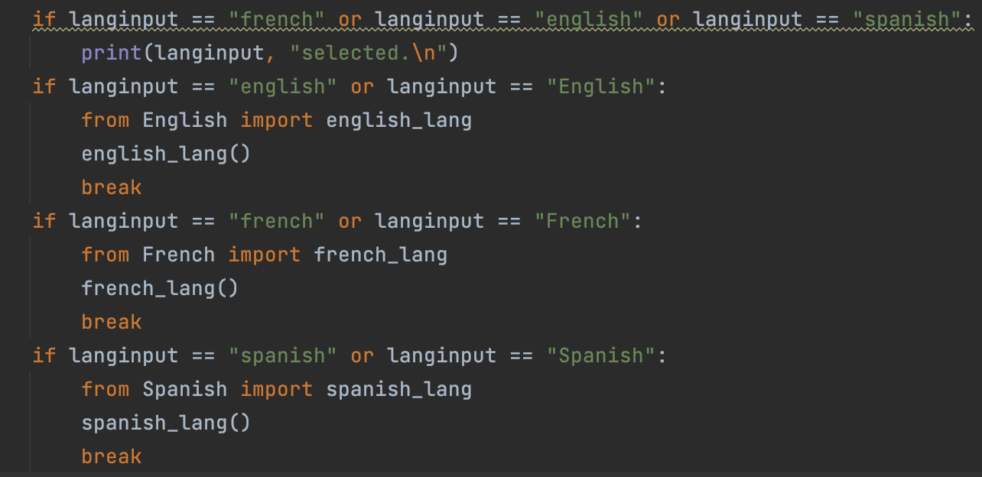
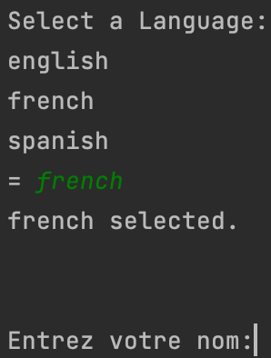
Trialling components - Language select
One thing I wanted to add was an option for the user to select which language they wanted the quiz to be in. I decided that using just English, French and Spanish would be the best idea as they are some of the most widely spoken languages in the world. Combined there are over 2 billion people in the world who speak one of these three languages and that accounts for around 40% of everyone in the world.
I programmed it so that if someone were to select a language, then they would need to type out the name of it, for example, “French”. However, a lot of people would type this out without the capital letter. To fix this, i made two spellings of each language, one with a capital letter and one without. This way the only way for there to be an error would be if the spelled the word wrong, they typed in a language that wasn’t french english or spanish, or they typed in either french and spanish how they are spelt in those languages (français and español). However i think the chances of this are low, since because the introduction and title to the quiz is in english, most people would assume to type the languages how they are spelt in english.

Slide 12
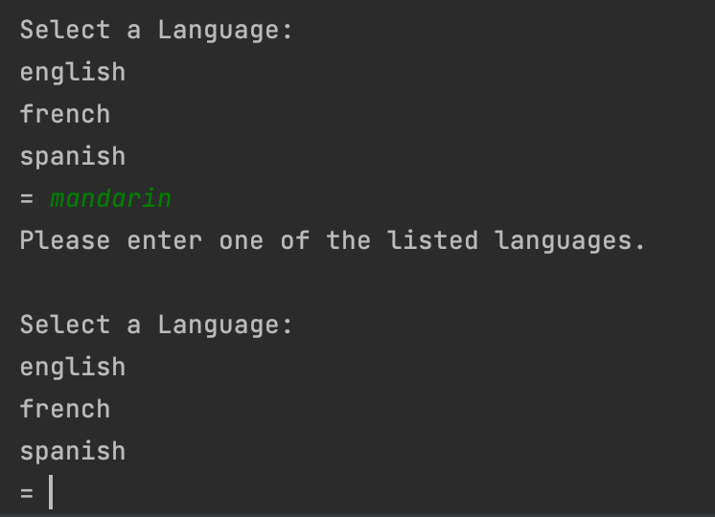
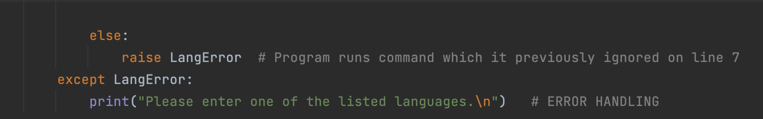
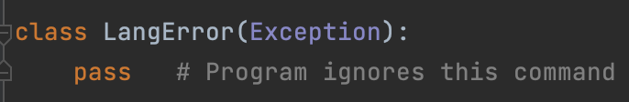
Trialling components - Error handling
Before, when I set the different languages that a user could select, If they didn’t give an input that i had set (french, english and spanish), then the program would stop running and an error message would pop up. To fix this, i wanted to make a command that would show a message that told the user they had made a mistake and then re-run the language select command. To do this, I at first just copied the language select command and pasted it in several times because I wasn't sure of any other way to do it. But there were several problems with this. One of this being that there were a finite number of times a user could attempt this and secondly that it made the code very messy. I did some research and found that the best way to do this was to use the ‘raise’ and ‘pass’ commands. The pass command tells the program to ignore a line of code unless directly told to by the raise command.
Result of raise and pass commands

Slide 13
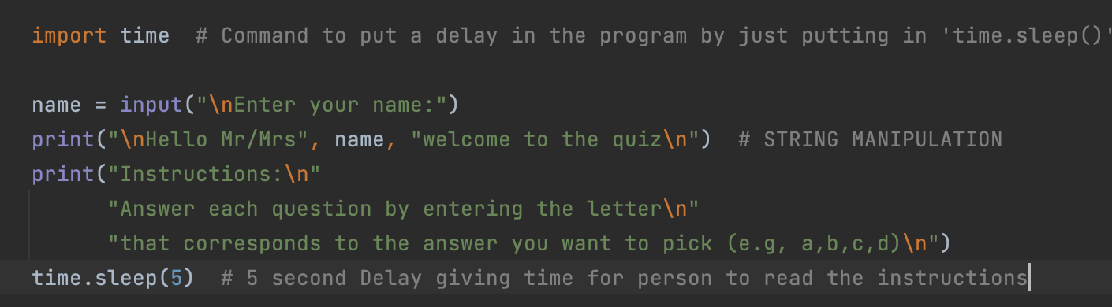
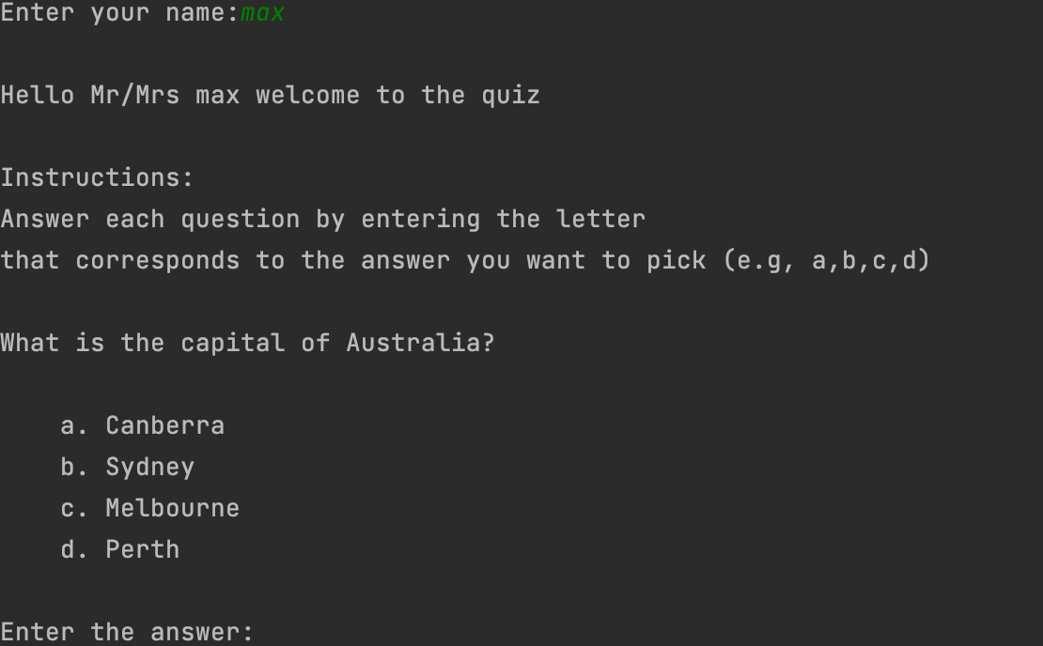
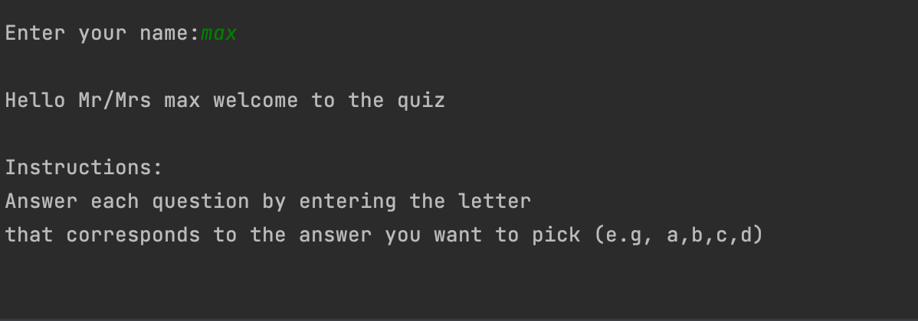
Trialling components - Import Time
A problem I faced once i first tested the quiz and the language select was that there was no time for the user to read the steps to the quiz as well as being able to tell if they got an answer wrong or right. I discovered a feature called import time where i could use the command ‘time.sleep(5)’. This would delay the next command from running for 5 seconds and I could change that time period if i wanted to. This allowed me to be more free with the things like the instructions to the quiz and telling the user if they got the question right or wrong by making the text longer with more information and giving the user an appropriate amount of time to read it.
After 5 seconds:
Before 5 seconds:

Slide 14
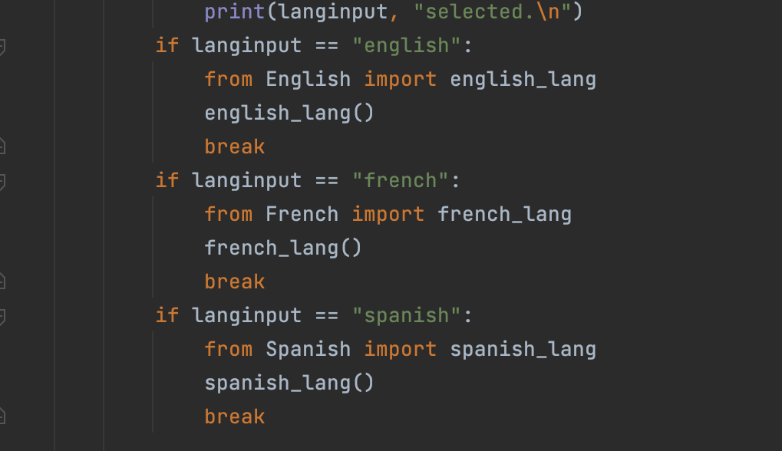
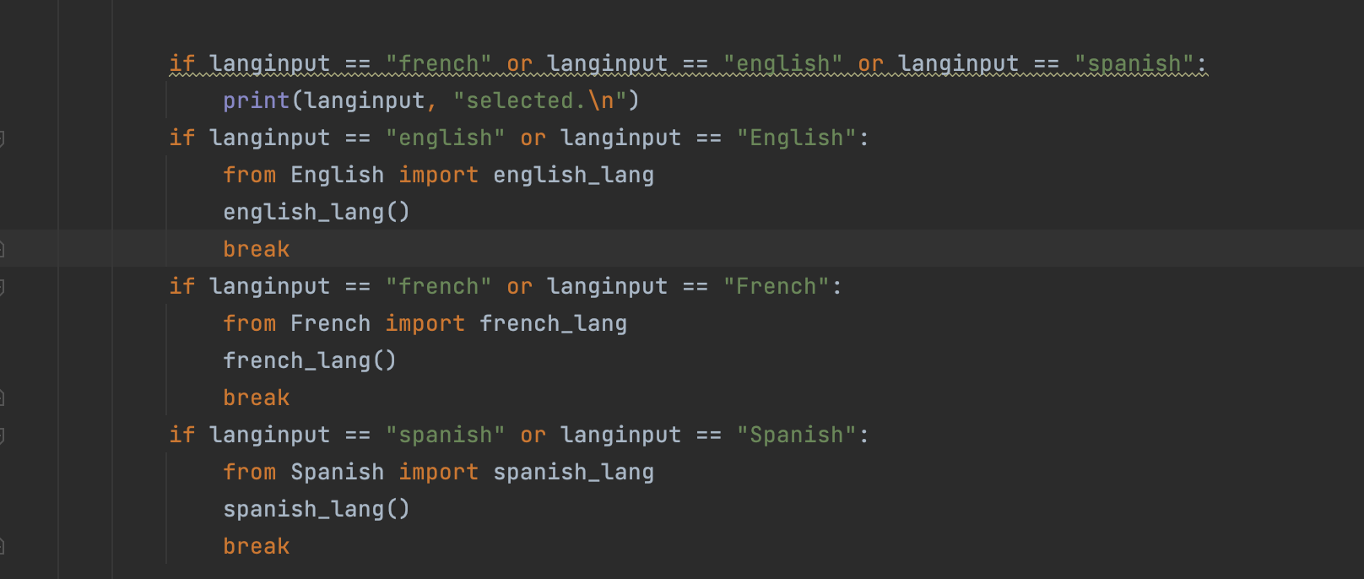
Self-Testing(video)
Screen recording of original language select issue
Screen recording of fixed product
An issue i had with the language select feature i implemented was that if the user was to type it out with the first letter of the language with a capital (French, Spanish) then it wouldn’t work and there would be an error message. To fix this, i made it so there were 2 correct spellings of each language as in reality, there as about a 50/50 chance to whether the user would type it out with a capital or without one and so instead of just picking one spelling i implemented both.

Slide 15
Stakeholder Feedback
Instructions aren’t clear enough, I started typing out the answer to the questions in words instead of typing A,B,C or D.
I can’t see whether i get the question wrong or right as the program instantly moves onto the next question with no interval (maybe add in a time delay).
It would be good if at the end of the quiz, i was able to see how many questions I got right out of how many questions there were e.g. 7/10, rather than what it is at the moment where it just says the total amount of questions I got right e.g. 7. There is no way to interpret if i got a high score or a low score.

Slide 16
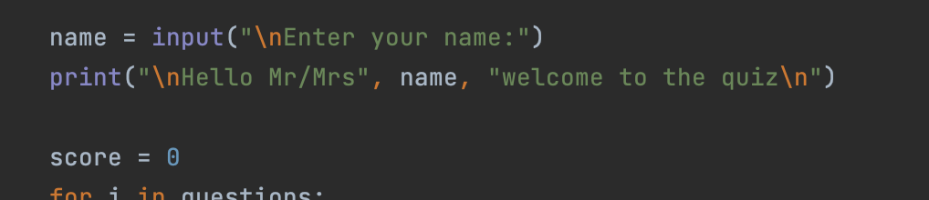
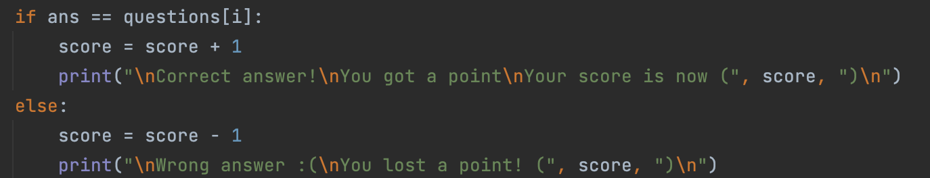
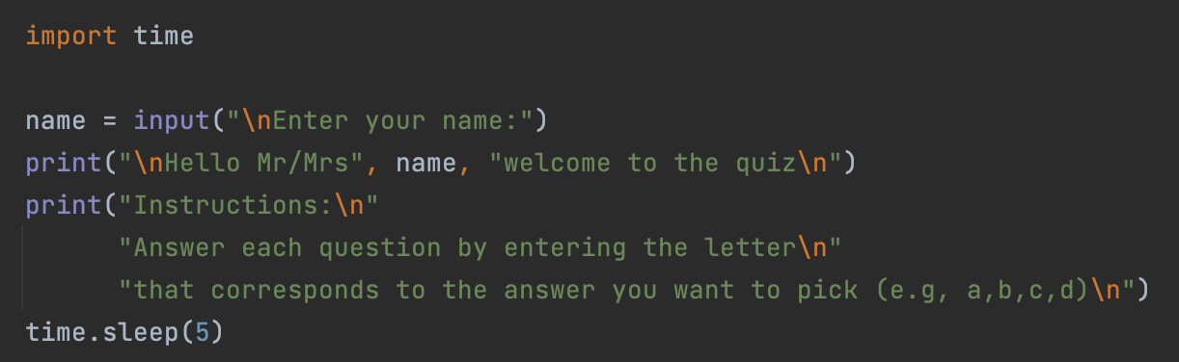
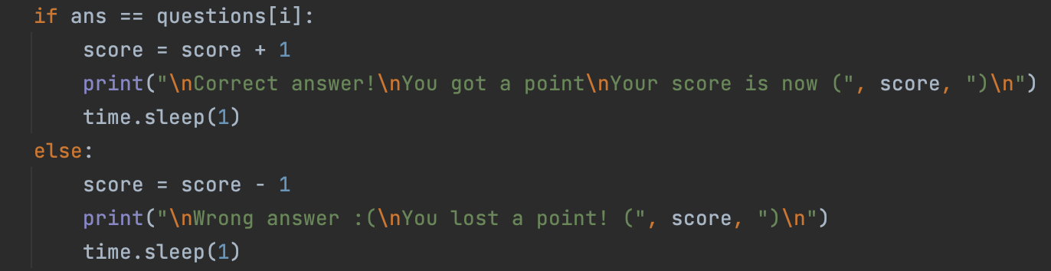
Implementing Stakeholder Feedback
To fix the issue where the stakeholder didn’t know how they should type out the answer, i wrote out a set of instructions that could be easily followed in all three of the languages i had. To prevent the instructions from going unnoticed, i used the import time feature which allowed a 5 second delay where the user would have plenty of time to read the instructions. This time feature also was the solution to the 2nd problem where the stakeholder mentioned that they weren’t able to tell if they got the question right or not because the program would instantly print the answer to the question and print the next question at the same time. I put a 1 second delay after the results for each question were displayed and after testing this, it seemed like an appropriate amount of time.
Before:
After:
The last piece of stakeholder feedback was making the total score at the end of the quiz more clear and this was an easy fix, i just had to use the command str(len(questions))

Slide 17
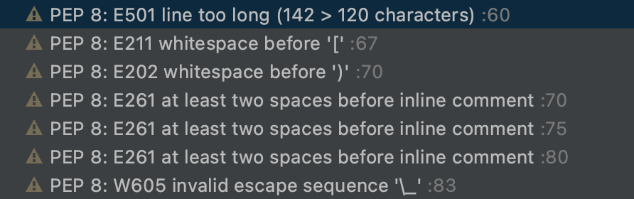
PEP8
While going through and correcting my list of errors, I noticed that the vast majority of errors were labelled ‘PEP8’. After some researching I discovered that it was just indicating that I hadn’t followed the conventions of python. This is basically just the grammar of which python uses to say that there is a correct way of formatting it, how many empty lines there should be after a line of code etc.

Slide 18
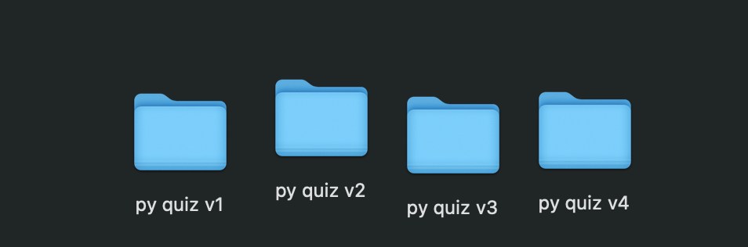
Version control
To ensure that i didn’t break my code beyond repair where i couldn’t get back to the point i wanted to, no matter how many times i pressed ctrl z, I made several save files of the program at various stages during the development process. I was extremely thankful to myself that i did this because there was a point in the assignment where my code was almost completely broken and it had almost no functionality. I spent almost a full period of class trying to figure out what the issue was but to no avail. Fortunately this only occured 2 days after i had made the 3rd save file and therefore i was able to use that and caught up to where i previously was the very next day.

Slide 19
Relevant Implication 1 - Functionality
The functionality of a program is the ease of using it and if the users find it difficult or not to understand. It should be easy enough to understand for the user to not give up and stop playing it half way through, but not too easy that the program just runs itself with no user inputs.
Functionality was definitely something that i focused on the most and i believed that i have achieved the level of functionality that i set for myself. To make sure that the user doesn’t accidentally start typing in the answers to the questions as words instead of A, B, C or D, I put a set of instructions that are easy to understand in all 3 of the languages.
I also made sure that in the language select feature, if the user didn’t input a correctly listed language then there would be an error message, clearly stating “Please select one of the listed languages”

Slide 20
Relevant Implication 2 - Privacy
The privacy of a program is dependent on how much data the program collects from the user, these things could be as simple as their name or their final score.
Nowhere in my program do i mention that i collect any of the user’s data, and therefore i have no right to do so. The only possible things i could’ve kept track of was the user’s score and name, however all of that data is deleted once the program has ended and therefore there is nothing that the user needs to worry about.

Slide 21
Relevant Implication 3 - Sustainability and future proofing
The level of sustainability and future proofing a program has is how easy it is to adapt the code to the needs of a user in the future. This aspect is important as without it, in the future if it is neglected, then the code could become redundant.
My program could be easily adapted to the future as there would really only be 2 aspects which could be subject to change. One of them is the Amount of Languages. In the future, the most spoken languages may not necessarily be English Spanish and French and so i may need to simply just translate the program into a new language which isn’t very time consuming. Another thing that i might need to change is the answers the questions in the quiz as the world is constantly changing.

Slide 22
Relevant Implication 4 - accessibility
The accessibility of a program is how available it is for people to access it. The most basic form of this is having it in multiple languages as that way you are targeting a much wider audience rather than just those who can speak your mother tongue.
After functionality, accessibility was definitely something that i paid extra attention to and it was the main reason i chose to implement a language select feature. As i have mentioned multiple times throughout this presentation, the reason that i chose the languages English, Spanish and French was because they are the some of the most widely used languages in the world, with a combined total of over 2 billion people who can speak at least one of these languages.

Slide 23
Evaluate
At the start of the development process, I made a trello board, this gave me a clear representation of what needed to be done and i had a way where i could keep track of that, By using this, i was able to know if i was ahead of schedule or if i needed to do some catching up.
Another thing i used to help me with the planning of my project was a bar graph showing estimates of how long i thought each feature of the program would take. This combined with the trello board were the sole reason i finished on time as i was able to have all the information i needed before starting with the development of my program.

Slide 24
Evaluate - continued
By setting aside time for myself to trial the program, I was able to identify errors that would have otherwise gone unnoticed. An example of this was the problem i had where the user would get an error for typing out the languages with a capital instead of a lowercase letter. I would not have possibly notice this if it weren’t for me trialling the program.
Because i had another person test the quiz for me that had never see in previously, i was able to greatly improve the functionality. Mainly when it came to the instructions and the time delays.

